Slide 1
Getting help and helping others (including future you)
Peter Hickey
@PeteHaitch
Single Cell Open Research Endeavour (SCORE),
Walter and Eliza Hall Institute of Medical Research

Slide 6
Writing the question will often help you figure out the answer

Slide 7
Asking for help can be hard
Not knowing what went wrong
Not knowing who or where to ask
Fear of misunderstanding, ridicule, criticism
Admitting you can’t solve a problem
Pressing send and figuring out you made a typo …
http://lcolladotor.github.io/2018/11/12/asking-for-help-is-challenging-but-is-typically-worth-it

Slide 8
Types of help
Problem
Is this a bug?
Why am I stuck?
How do I install X?
Questions
How do I do Y?
What tool should I be using?
How do I learn about Z?
Discussion, debate, and brain storming
Which design do you prefer?

Slide 9
Asking good questions
Good != judgement
There are no ‘dumb’ questions
Good questions:
http://www.bioconductor.org/help/support/posting-guide/
Make it easier for someone to help you

Slide 10
Get yourself organised
Read the docs, vignettes, and workflows
Turn it off and on again
BiocManager::valid()
Prepare an example

Slide 11
reprex
reprex = reproducible example
reprex = One of the most useful CRAN packages
https://speakerdeck.com/jennybc/reprex-help-me-help-you

Slide 13
reprex
Conversations about code are more productive when they contain code
Code that actually runs
Code that I don’t have to run
Code that I can easily run
You can copy+paste the reprex output directly into a GitHub issue, Bioconductor support forum post, StackOverflow post, etc.
Includes sessionInfo()
But please also(?) include BiocManager::valid()

Slide 14
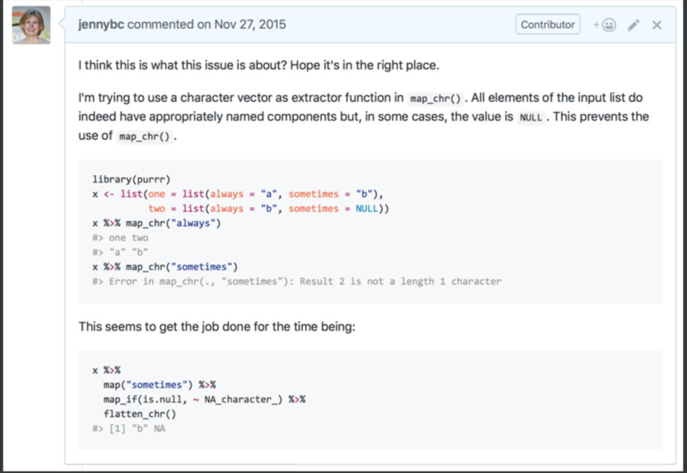

Slide 15
Public question platforms vs. safe spaces?
Lean on your current friend(s)
Find new friends
R4DS Community
R-Ladies (local and remote)
Bioconductor and rOpenSci Slack
Out into the big, bad world

Slide 16
Where to ask
Questions related to Bioconductor packages
http://support.bioconductor.org/
Questions about developing Bioconductor packages
https://stat.ethz.ch/mailman/listinfo/bioc-devel
Bug reports about a specific Bioconductor package
http://bioconductor.org/packages/<package>/ and see ‘BugReports’ field
www.github.com/<username>/<repo>/issues
Brain storming
https://bioc-community.herokuapp.com/
General questions about high-throughput sequencing or software unrelated to Bioconductor
https://www.biostars.org/ and http://seqanswers.com/
General R questions
https://stat.ethz.ch/mailman/listinfo/r-help
https://stackoverflow.com/questions/tagged/r
https://community.rstudio.com/ (especially for all things RStudio and tidyverse)

Slide 17
Where to ask
Twitter
#rstats is a (generally) friendly place
Good for debate/discussion/brain storming questions
But not so well-suited to longer/technical questions
Email
(Opinion): Try to favour a public-ish forum so that others may benefit
Responding to email stresses me the hell out.
You never know when someone is using Twitter …
Mailing lists
R special interest group (SIG) mailing lists
Rcpp
macOS
https://masalmon.eu/2018/07/22/wheretogethelp/

Slide 18
Common concerns
My data is confidential
Oftentimes, using randomised gene and sample names suffices
My data is too big
Subset
Dropbox

Slide 19
Found your answer?
Share it!
Post back to the support forum, issue ticket
Write a blog post
Tweet
Thank people who helped!
Up vote, accept answers
They ain’t doing it for the $$$
Help future you!
Write a blog post
Write a gist (www.gist.github.com)

Slide 20
Helping others
Empathy!
Try to remember what it was like when you were learning this topic
Assume the best of people
Aim for constructive comments

Slide 21
Tips n tricks
Search on Bioconductor support forum kinda sucks …
Use google!
site:support.bioconductor.org <query>
E.g.,
site:support.bioconductor.org plotMDS
Bioconductor support forum supports Markdown
But can sometimes go a little wonky …

Slide 22
Links
https://community-bioc.slack.com/
https://speakerdeck.com/jennybc/reprex-help-me-help-you
https://reprex.tidyverse.org
https://support.bioconductor.org/info/faq/
http://www.bioconductor.org/help/support/posting-guide/
http://www.bioconductor.org/help/faq/
http://lcolladotor.github.io/2018/11/12/asking-for-help-is-challenging-but-is-typically-worth-it/
https://www.tidyverse.org/help/
https://masalmon.eu/2018/07/22/wheretogethelp/
https://ropensci.org/blog/2017/02/17/comm-call-v13/

